Slide 1
Monthly Update
Simulations portion by Alex

Slide 2
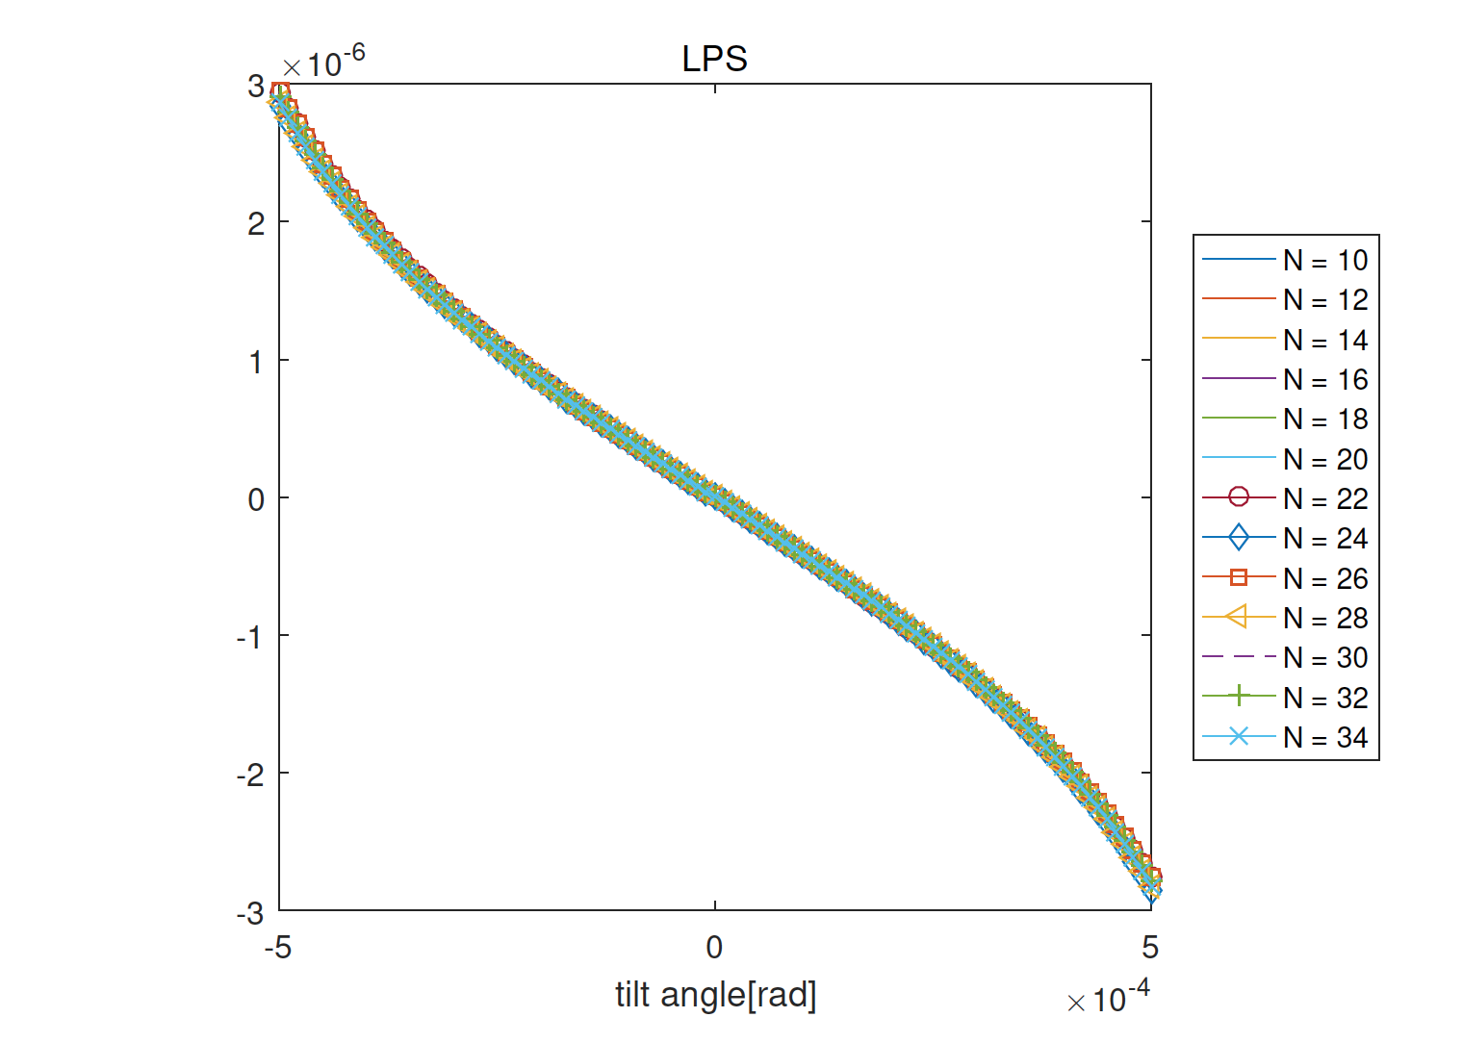
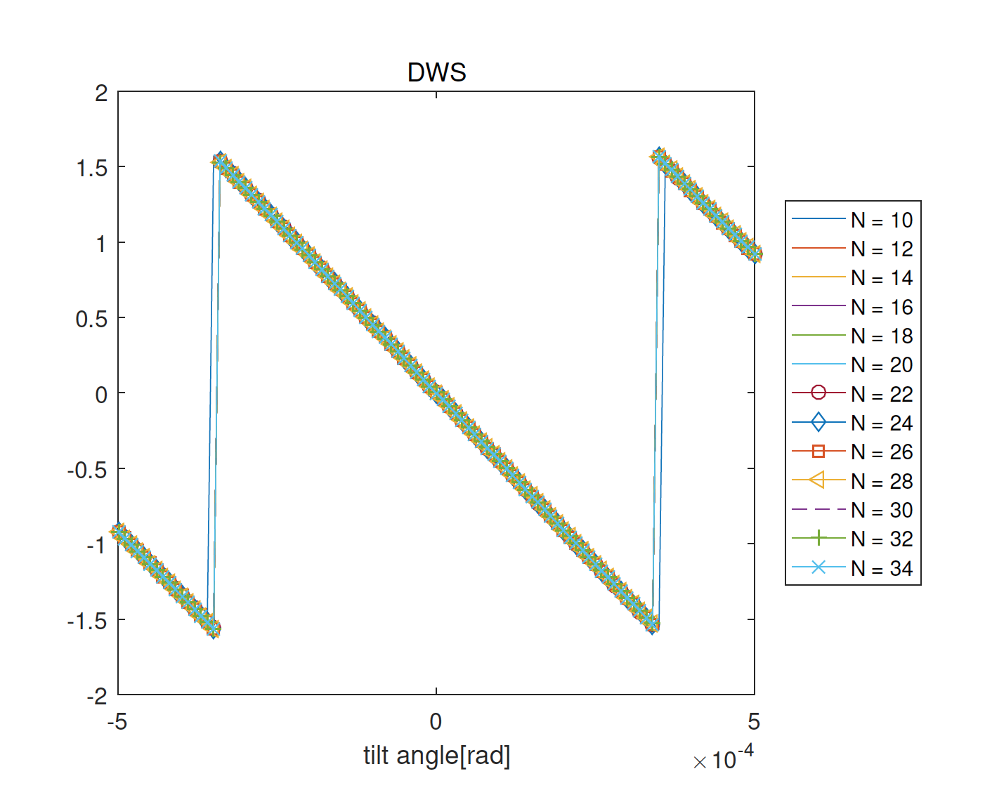
Simulating effects of RX beam tilt and offset on mission signals (collaborating with AEI on this)
RX Beam
LO Beam
Beam Waist
Signals (Length and DWS) converge at lower mode order
when lateral offset (movable aperture effect) couples with tilt
Prior examination with no offset led to oscillatory progression with mode order
y
y
z
x
x
y
Setups
y
z
x
x
AEI ifoCAD results: DWS Agree →
LPS Disagree →
Problem: Using different definitions of beam orientation ----- FIXED------ upgraded programs for more general beam orientations

Slide 3
M2 Beam Spread
Fundamentally non-gaussian
Best fit for gaussian beam, only 60 percent of power and not what we expect, graphic shows M2 beam 1000 zR, or about 8 mm from M2, best resembles a Gaussian beam with waist 1.5 times what we expect (or the beam at M2) and about -7zR behind were we expect it’s waist to be located
Still a poor fit
Working on recreating beam to
get true TX beam form

Slide 4
Monthly Update
Simulations portion by Paul E.

Slide 5
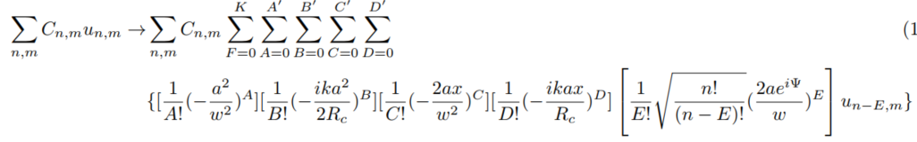
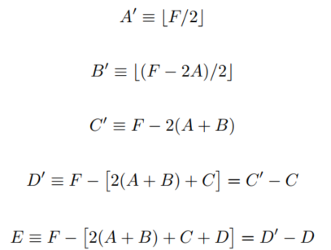
Generalized K^{th}-order Expansions of Laterally Offset Beams

Slide 6
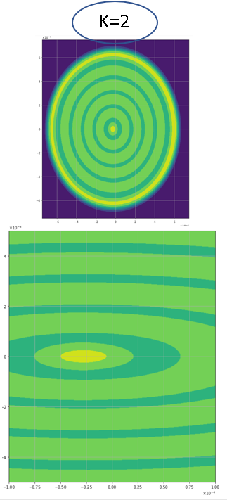
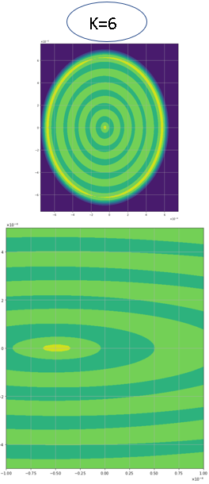
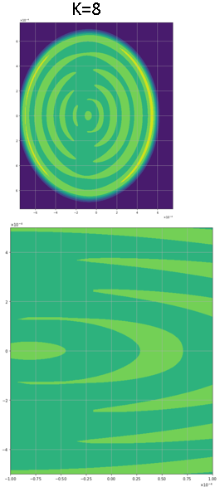
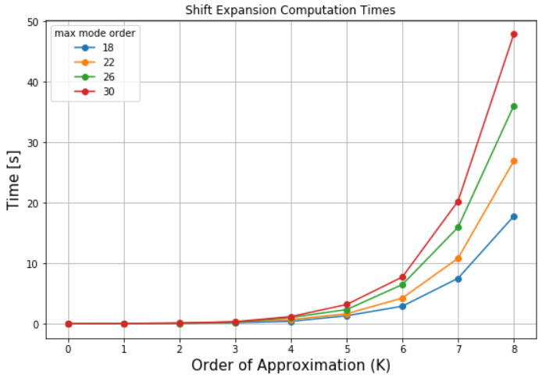
Visualizing Expansions : Tophat Intensity Plots
Generalized K^{th}-order Expansions of Laterally Offset Beams
Given a set of mode coefficients C_{n,m}:
any shifted beam in the HG representation is redefined with a set of on-axis modes with updated coefficients for more rapid signal calculation on interference with a reference Gaussian beam at small misalignments
Uses generalized series expansions to any approximation order, K, in shift
Preliminary complete expansion time tests for various max HG mode order of an offset tophat
Analyzing signals convergence with the exact formulation for combinations of approximation order and offset magnitude
Shift:
25 micron
50 micron
75 micron
Order:

